Slide 1
CSS - selectors (Day 1)
Viktoras Lava www.viktoraslava.lt

Slide 2
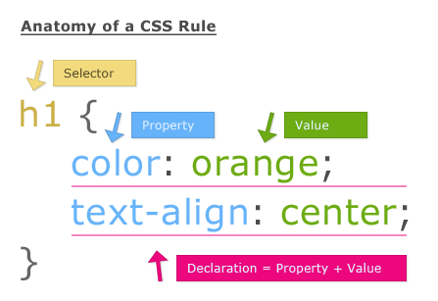
Diving deep into CSS
We already talked about CSS last week. Today we will talk about CSS simple selectors, pseudo-selectors, box model and floats.

Slide 3
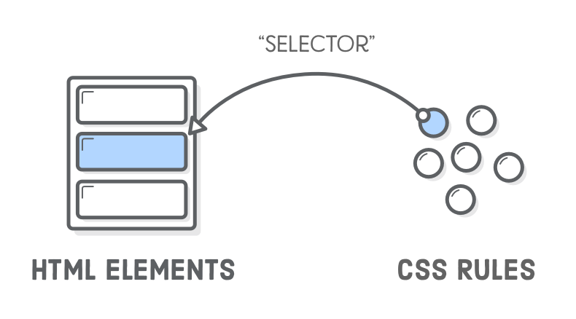
Selectors
There are more than 50+ CSS selectors. Usually they are categorized like this:
Simple selectors
Pseudo-selectors
for pseudo-classes
for pseudo-elements
Attribute selectors
Most of the time we use simple selectors in addition with pseudo-selectors. You can find the CSS selector list here.

Slide 4
Simple selectors
body { font-family: “Roboto”; }
#navigation { background: red; }
.button {background: blue; }
#navigation * { background: green; }
Element selector - used for defining global styles.
ID selector - used for defining unique element styles, id can be used one time in HTML.
Class selector - used for defining abstract styles, can be used many times.
Universal selector - used for selecting all elements, debugging.

Slide 5
Simple selectors ( )
<div>
<p>Tekstas</p>
</div>
<p>Tekstas 2</p>
div p { background: red; }
Selects all <p> elements, which are in <div> element.
Used for selecting elements inside other elements.
Example

Slide 6
Simple selectors ( , )
<div>
<p>Tekstas</p>
</div>
<p>Tekstas 2</p>
div, p { background: red; }
Selects all <div> and <p> elements.
Used for grouping CSS properties.
Example

Slide 7
Simple selectors ( + )
<div>
<p>Tekstas</p>
</div>
<p>Tekstas 2</p>
div + p { background: red; }
Selects all <p> elements that are immediately placed after <div> element.
Example

Slide 8
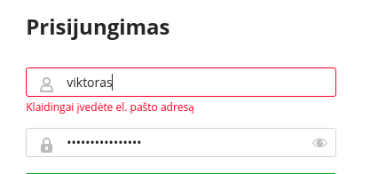
Simple selectors ( + )
div + p { background: red; }
Used inside forms to indicate, which input wasn’t valid.

Slide 9
Simple selectors ( > )
<div>
<p>Tekstas</p>
</div>
<div>
<strong>
<p></p>
</strong>
</div>
div > p { background: red; }
Selects all <p> elements where the parent is <div>.
Example

Slide 10
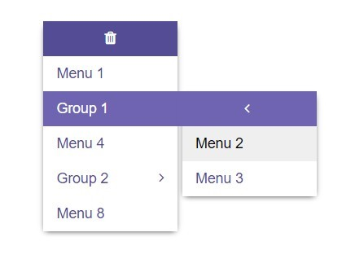
Simple selectors ( > )
div > p { background: red; }
Used for multi-level navigations.

Slide 11
Pseudo-selectors for pseudo-classes
Pseudo-selectors let’s us to select a pseudo-class. Pseudo-class is special state of an element.
The full list of pseudo-classes is here.

Slide 12

Pseudo-class :hover
div:hover { background: blue; }
Hover pseudo-class indicates when mouse is over the element.
Used to style an element when a user mouses over it.
Example

Slide 13
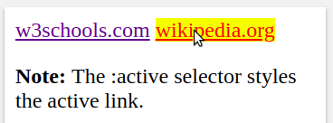
Pseudo-class :active
a:active { background: yellow; }
Active pseudo-class indicates when element is clicked.
Used to style an element when a user clicks on it.
Example

Slide 14
Pseudo-class :first-child
<body>
<p></p>
<h1></h1>
<p></p>
<div>
<p></p>
<p></p>
</div>
</body>
p:first-child
{ background: red; }
First child pseudo-class selects every <p> element that is the first child of it’s parent.
Example

Slide 15
Pseudo-class :last-child
<body>
<p></p>
<h1></h1>
<p></p>
<div>
<p></p>
<p></p>
</div>
</body>
p:last-child
{ background: red; }
Last child pseudo-class selects every <p> element that is the last child of it’s parent.
Example

Slide 16
Pseudo-class :nth-child(n)
<p></p>
<p></p>
<p></p>
<p></p>
p:nth-child(2)
{ background: red; }
Nth-child pseudo-class selects every <p> element that is the second child of it’s parent.
Example

Slide 17
Questions?

Slide 18

Homework
Do the homework in the google drive
Play the flexbox froggy game to train your display: flex skills.

